Slide 1
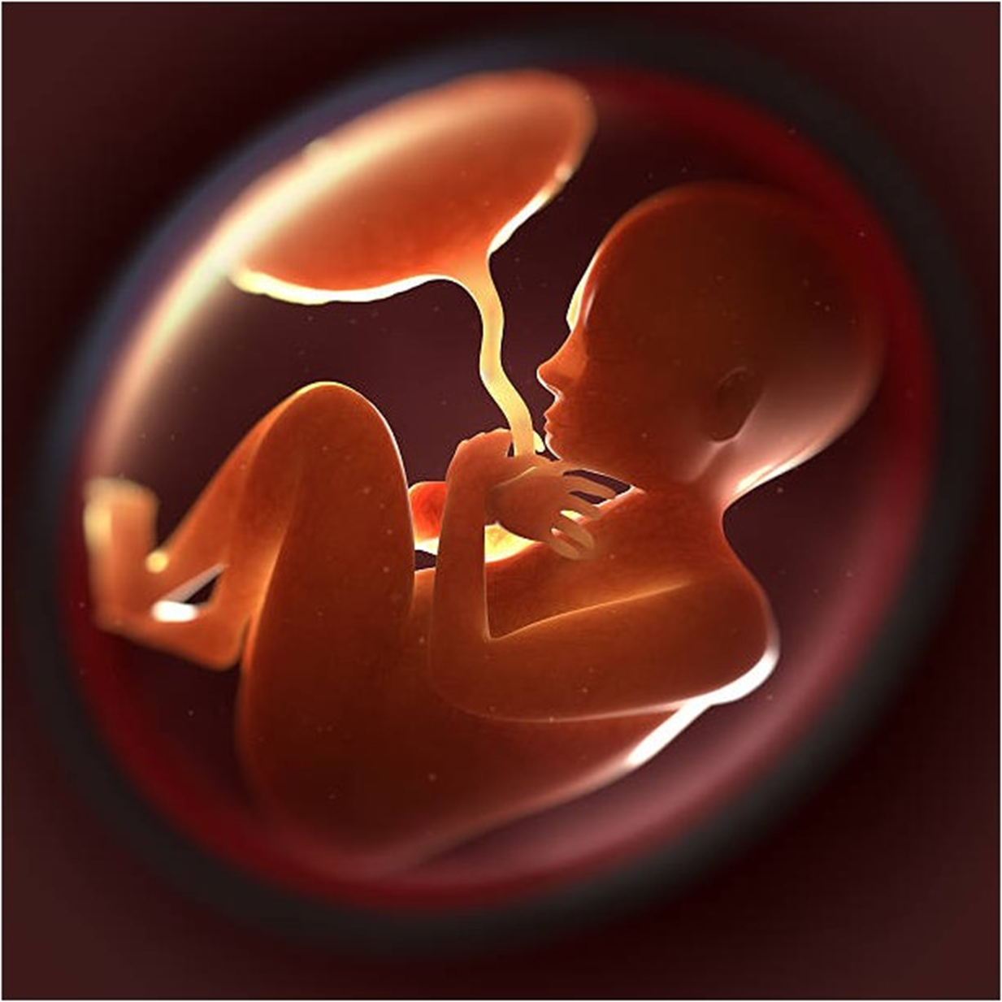
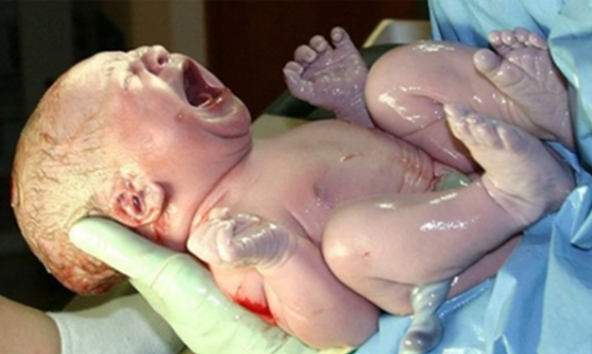
Born in the wild: Paramedics’ perceptions regarding unplanned prehospital births.
Michella Hill^{1,2}, Belinda Flanagan³, Brennen Mills¹, Sara Hansen¹, Luke Hopper²
¹School of Medical and Health Sciences, Edith Cowan University
²Western Australian Academy of Performing Arts (WAAPA), Edith Cowan University
³School of Medicine, University of Tasmania
Introduction
Theme 1: Paramedic preparedness
"I would just ask her to close her legs 'til we got to hospital"
Unplanned out-of-hospital births (OOHBs) are rare events, representing <0.05% of Australian paramedic prehospital callouts.¹
Unplanned OOHBs are at increased risk of complications including life-threatening conditions such as postpartum haemorrhage and neonate resuscitation.^{1,2}
OOHBs are on the rise both nationally and internationally, particularly following the SARS-CoV-2 outbreak.^{3,4}
Paramedics need to be confident in responding to the low-prevalence yet high-risk callouts.
The aim of this research was to investigate Australian paramedics’ perceptions of OOHB. This included previous training and education, confidence attending these types of callouts, and exposure or experience to OOHBs.
“I think skills decay is a massive issue for prehospital clinicians because even the clinical side of things is only a small aspect of it; it's extrication and accessing patients and deescalate situations ... the ones [situations] that are rarely encountered are rarely trained, which is the opposite to what we probably need.”
“So even in practical training days, most people don't actively participate, or a lot of people don't actively participate. Either they think they know, or they don't know, and they don't want to be shown up, or they don't think it's worthwhile, or for whatever reason”.
Methods
Theme 2: Paramedic apprehension attending imminent births
Semi-structured qualitative interviews were undertaken in late 2021.
Participants were recruited via purposive and convenience sampling methods, and utilised snowball sampling.
Interviews were conducted either via video-conference or in person, depending on participant location and SARS-CoV-2 restrictions.
Interviews were audio-recorded and transcribed verbatim.
Braun and Clarke’s⁵ approach to thematic analysis was utilised.⁵
[Regarding neonate complications and resuscitation] “they are tough cases and not nice to handle”
"I think if I turn up to a regular birth, uhm, I would be, there's no doubt in my mind that I would just be so overloaded with that adrenaline response that I would just be going through the motions. I'm, I would have very little ability to try and think critically. Because it's so rare, I would just be desperately trying to remember the basics. Just a handful of dot points that I can recall and kind of work my way through and hope that they do the trick."
Theme 3: Patient-centred care (specific to OOHBs)
"I don't think we're very good at history-taking. We don't ask enough questions … I think people sometimes are scared if a woman is in labour and she's you know, pushing, concentrating quite hard on the contractions, we aren't quite as comfortable with being willing to ask questions and ask more information because we're respectful of the fact that she's contracting and she's obviously working quite hard, but it's a barrier between us and our communication; so I don't think enough things are asked of patients, and they can answer.”
"Because that's certainly the message that I've got from reading and listening to other peoples’ research in this whole space. Is that what stands out is, is never, is never about, they fumble around when they were trying to clamp the cord. It's about, they made me feel terrible because they shoved me into the ambulance. Because all they [the paramedic] wanted to do was get out of there..."
Results
Fourteen participants from jurisdictional, military and industrial ambulance services were interviewed.
Five participants were male, and six were from rural regions.
Participant experience ranged from 1.5 to 20 years in the role (combined 105.5 years on-road)
Four main themes emerged:
Paramedic preparedness
Paramedic apprehension attending imminent births
Patient-centred care (specific to OOHBs)
Desired Training
Participants reported sporadic or infrequent training in birthing and obstetric emergencies. Participants had no exposure to birthing experiences during their undergraduate degree, with zero to minimal subsequent exposure in the workplace. The most experienced paramedic (20 years) had attended only six OOHBs. Participants with little or no experience reported low confidence, and even more experienced participants reported increased anxiety when attending OOHBs, particularly surrounding potential complications for the birth parent or neonate, or if there were long distances to definitive care. There is considerable risk associated with poor confidence when attending OOHBs combined with limited exposure and practice opportunities. Complications can be life-threatening, and paramedics need to be adequately trained to recognise and manage these conditions.
Theme 4: Desired training
Specific requests to shadow a midwife for more substantial exposure and hands-on practice reflect the current deficiency felt by participants, however, may be impractical given the scarcity of available placement opportunities.
"The one thing, one thing that always resonated with me, and I can't remember who told me this, but don't treat mums and babies as sick people. They're healthy people who are going through a normal process, so allow them to have the decision in their own process."
References
Discussion & Conclusion
Flanagan B, Lord B, Barnes M. Is unplanned out-of-hospital birth managed by paramedics ‘infrequent’,‘normal’and ‘uncomplicated’?. BMC pregnancy and childbirth. 2017 Dec;17(1):1-9. DOI 10.1186/s12884-017-1617-9
McLelland G, McKenna L, Morgans A, Smith K. Epidemiology of unplanned out-of-hospital births attended by paramedics. BMC pregnancy and childbirth. 2018 Dec;18(1):1-9. DOI 10.1186/s12884-017-1638-4
Townsend R, Chmielewska B, Barratt I, Kalafat E, van der Meulen J, Gurol-Urganci I, O'Brien P, Morris E, Draycott T, Thangaratinam S, Le Doare K. Global changes in maternity care provision during the COVID-19 pandemic: a systematic review and meta-analysis. EClinicalMedicine. 2021 Jul 1;37. DOI:https://doi.org/10.1016/j.eclinm.2021.100947
Siman-Tov M, Strugo R, Podolsky T, Blushtein O. An assessment of treatment, transport, and refusal incidence in a National EMS's routine work during COVID-19. The American Journal of Emergency Medicine. 2021 Jun 1;44:45-9. https://doi.org/10.1016/j.ajem.2021.01.051
Braun V, Clarke V. Using thematic analysis in psychology. Qualitative research in psychology. 2006 Jan 1;3(2):77-101.
Getty Images. Amniotic Sac Pictures. 2011, May 08. Available from https://www.istockphoto.com/search/2/image?phrase=amniotic+sac
National Geographic. Baby’s first bacteria depend on route of delivery. 2010, June 23. Available from https://www.nationalgeographic.com/science/article/babys-first-bacteria-depend-on-route-of-delivery
Paramedics felt insufficient training time was dedicated to OOHBs and associated complications during undergraduate education and organisational training.
With unplanned OOHB rates increasing, it is essential for paramedics to retain the specialised skills to minimise negative impacts on patient care and outcomes.
These results have informed development of a virtual reality training program for prehospital clinicians in the care of a newborn including the one-minute Apgar.

